Slide 1
Dynamic Car Racing

Slide 2
guide: dr. ashwin
GROUP MEMBERS
Asif Ali Sherani (19MIM10104)
Dhruv Arora (19MIM10014)
Naman Arora (19MIM10057)
Shrey Shrivastava (19MIM10056)

Slide 3
Introduction
Games have become an integral part of everyday life for many people.
A traditional game often presents a situation where players engage in an artificial conflict, defined by rules and results in a quantifiable outcome.
The racing game is a contemporary video game, and its objective is a car race against a game-controlled car.

Slide 4
Existing work with limitations
Today there are numerous racing games that uses the technology of artificial intelligence in the racing bots in the game.
Traditionally, hard-coded methods such as state machines, rule bases systems, and scripting are used for AI in commercial games. The problem with these methods is that they are static, can be hard to expand, and time is needed to hand tune parameters.
All AI bots are all the same due to which the real time players gets bored playing the same game again and again. As such it seems that the bots are not interactive with the players.
Some of the racing games available nowadays are Need for speed(NFS), Forza horizon, real racing etc.

Slide 5
Proposed work
Using blender to create models of the assets required throughout the game I.e. cars, race tracks, roads etc.
Using unreal engine as the game engine which should also provide us with a physics and rendering engine.
Programming of game mechanics in C++ using Microsoft visual studio.
Using tensor flow python library for development of game AI.
Initial training of the game AI.

Slide 6
methodology
The enemy AI will keep track of the constant changing of race course and obstacles.
The enemy AI will change its course of action by analyzing the actions performed by human player
The enemy AI will interact with the environment and human player to give an immersive experience

Slide 7
Novelty of the project
Usually the AI implementation in games is static i.e. the bot does not interact with player.
The implementation here is dynamic i.e. its difficulty level will change during the gameplay because of its interaction with the player.
Usually the game pre determines the difficulty level based on the input given by the player and it remains constant throughout the game until and unless changed explicitly by the user whereas here the difficulty of the game will be changing throughout the game by assessing the skills of the player during gameplay.

Slide 8
Real time usage
Having intelligent bots as competition or help in a game allows players to experience multi-player gameplay without being online.
Game bots can help you boost retention and grow your Instant Games.
Game Bots can be a powerful retention and re-engagement mechanic when used effectively, but used poorly they can provide an annoying player experience and drive users away from your game.
Bots tend to be more successful when considered as an integral part of the core engagement loop and a key component of the initial game design, as opposed to an ill-considered add-on at the end.
In fact, we've seen game developers increase their retention by over 25% by incorporating bots and optimizing the experience.

Slide 9
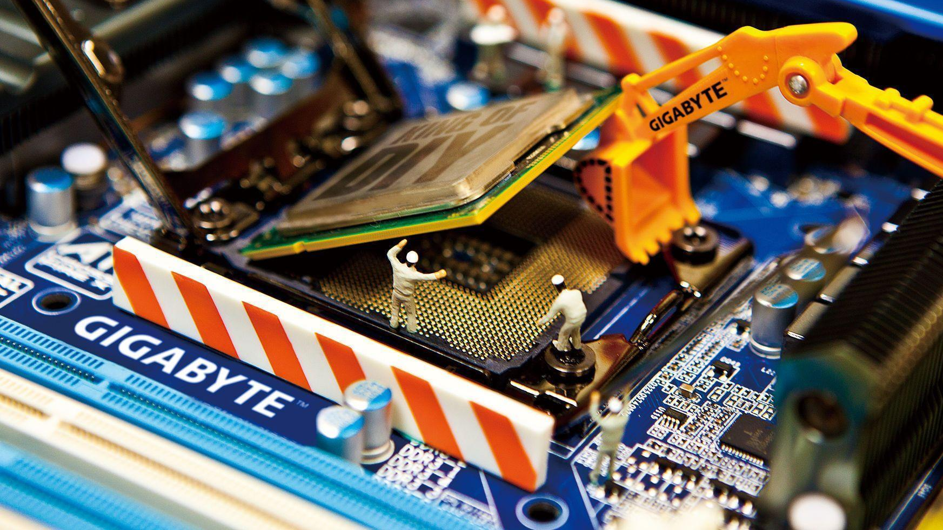
Hardware and software requirements
Hardware requirements:
Desktop PC or Notebook computer
For unreal engine:
Windows 7 sp1 or later / mac OS 10.9.2 or later.
Quad-core intel or AMD processor, 2.5 GHZ or faster.
8 GB RAM or more.
Nvidia GEFORCE GTX series or AMD Radeon series graphics card.
Software requirements:
Windows/ Mac OS or Linux.
Microsoft visual studio community edition.
Microsoft visual studio code.
Unreal engine 4.

Slide 10
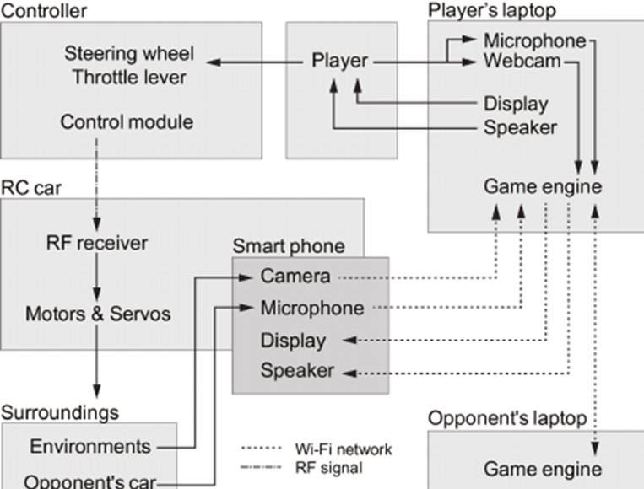
Overall system architecture diagram

Slide 11
Literature Review
Car racing games in particular have evolved somewhat over the years. The first racing game dates back to the early 1970s.
The 1990s was a pivotal era for car racing games. Geoff Crammond helped to develop Formula One Grand Prix in 1992, which was the new champion of simulation racing.
By the mid-1990s, 3D technology was ripe in gaming and that was no different for racing car games.

Slide 12
Literature Review (Continued...)
Today, car racing video games have transformed from one-dimension, low quality gaming experiences to a 360-degree, high definition experience with a plethora of suitable options.
In recent years, game makers have taken a more sophisticated approach to NPCs. In the future, we can expect to see more advanced AI appear in racing games.
virtual reality in racing games could be the next big development in racing games.

Slide 13
Module Description
For this Car Racing Game, we would like to accomplish a video game imitating the existing game with a projective view. The theme of our game is to compete with an opponent that is controlled by computer in a racing tournament.
This game consists of three major modules.
First part is the Game Logic Generator
The second part is the Screen Rendering Module
The last part is the Audio Module.

Slide 14
Game logic module (software)
The Game Logic Module generates all the motion control signals of all the objects in this game according to various algorithms.
To implement the action of moving forward, we first make the end of the road at the center of the screen to make sure the player’s focus is on the road. Then we create stripes of two different patterns, one is light and the other is dark. We keep switching positions of two kinds of stripes to generate the effect of moving the road.
We use the left and right key to control the left and right movement of player’s car. When left or right key is pressed, we move the position of the car to the left or right lane.

Slide 15
Sprite Control Module
The Game Logic Module provides the X and Y coordinates for different objects, like trees, clouds, cars, scores, speed, which is also called Sprites.
The Sprite Controller Module merges the different Sprites to generate the final RGB information for displaying on the screen.
The software generates the coordinate (X, Y) of different Sprites and passes coordinates to the Avalon Bus through the Kernel Driver.
Then these data accompanied with address information in update the register file related to the specific Spite, the Sprite Controller fetches the RGB information from specific Sprite picture ROM, which finally merges all the pictures according to the priority and send to VGA module.
The picture is finally showed on the screen. To make the Sprite move, the software just update the (X, Y) coordinate register file continuously.

Slide 16
Audio Design
Audio Generator Module is designed to send instructions to the Audio Controller Module in order to play appropriate sound effect according to the game processes.
For example, the background music is always on during the period when game is on. And special sound effects are integrated when the specific situations happen.
At the beginning of the game, the software extracts the background sound sample previously stored in the SDRAM and load it into the circular queue in the Audio Controller Module, which will continuously send signals to play the background sound sample until the player exit the game.
During the car racing, the software continuously checks whether the player hits the acceleration or braking button, or if there is any collision happens. Whenever a specific situation is detected, the software will load the corresponding special sound effect into FIFO, and play the special sound effect.

Slide 17
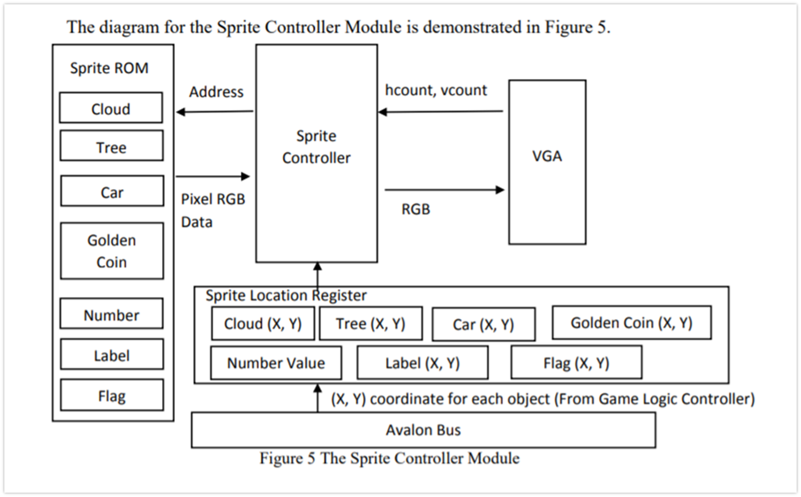

Slide 18
Module work flow explanation
This description of a general workflow focuses on the different steps of creating 3D game car and racing track.
For example, in a small independent game studio all of the steps could be performed by a single artist, instead of several specialized artists dedicated to each different task.
In addition to describing the different steps in the workflow of creating a 3D game character, some of the technical concepts related to the process will also be explained.
There are also tools and programs that attempt to automatically UV unwrap a 3D model, or pack the UV map effectively to maximize the use of texture space.

Slide 19
Implementation and coding
Car mesh:
Acar_racingPawn::Acar_racingPawn(){
static ConstructorHelpers::FObjectFinder<USkeletalMesh> CarMesh(TEXT("/Game/VehicleAdv/Vehicle/Vehicle_SkelMesh.Vehicle_SkelMesh"));
GetMesh()->SetSkeletalMesh(CarMesh.Object);
static ConstructorHelpers::FClassFinder<UObject> AnimBPClass(TEXT("/Game/VehicleAdv/Vehicle/VehicleAnimationBlueprint"));
GetMesh()->SetAnimationMode(EAnimationMode::AnimationBlueprint);
GetMesh()->SetAnimInstanceClass(AnimBPClass.Class);
// Setup friction materials
static ConstructorHelpers::FObjectFinder<UPhysicalMaterial> SlipperyMat(TEXT("/Game/VehicleAdv/PhysicsMaterials/Slippery.Slippery"));
SlipperyMaterial = SlipperyMat.Object;
static ConstructorHelpers::FObjectFinder<UPhysicalMaterial> NonSlipperyMat(TEXT("/Game/VehicleAdv/PhysicsMaterials/NonSlippery.NonSlippery"));
NonSlipperyMaterial = NonSlipperyMat.Object;
UWheeledVehicleMovementComponent4W* Vehicle4W = CastChecked<UWheeledVehicleMovementComponent4W>(GetVehicleMovement());
check(Vehicle4W->WheelSetups.Num() == 4);

Slide 20
Wheels
Vehicle4W->WheelSetups[0].WheelClass = Ucar_racingWheelFront::StaticClass();
Vehicle4W->WheelSetups[0].BoneName = FName("PhysWheel_FL");
Vehicle4W->WheelSetups[0].AdditionalOffset = FVector(0.f, -8.f, 0.f);
Vehicle4W->WheelSetups[1].WheelClass = Ucar_racingWheelFront::StaticClass();
Vehicle4W->WheelSetups[1].BoneName = FName("PhysWheel_FR");
Vehicle4W->WheelSetups[1].AdditionalOffset = FVector(0.f, 8.f, 0.f);
Vehicle4W->WheelSetups[2].WheelClass = Ucar_racingWheelRear::StaticClass();
Vehicle4W->WheelSetups[2].BoneName = FName("PhysWheel_BL");
Vehicle4W->WheelSetups[2].AdditionalOffset = FVector(0.f, -8.f, 0.f);
Vehicle4W->WheelSetups[3].WheelClass = Ucar_racingWheelRear::StaticClass();
Vehicle4W->WheelSetups[3].BoneName = FName("PhysWheel_BR");
Vehicle4W->WheelSetups[3].AdditionalOffset = FVector(0.f, 8.f, 0.f);
// Adjust the tire loading
Vehicle4W->MinNormalizedTireLoad = 0.0f;
Vehicle4W->MinNormalizedTireLoadFiltered = 0.2f;
Vehicle4W->MaxNormalizedTireLoad = 2.0f;
Vehicle4W->MaxNormalizedTireLoadFiltered = 2.0f;

Slide 21
Engine
Vehicle4W->MaxEngineRPM = 5700.0f;
Vehicle4W->EngineSetup.TorqueCurve.GetRichCurve()->Reset();
Vehicle4W->EngineSetup.TorqueCurve.GetRichCurve()->AddKey(0.0f, 400.0f);
Vehicle4W->EngineSetup.TorqueCurve.GetRichCurve()->AddKey(1890.0f, 500.0f);
Vehicle4W->EngineSetup.TorqueCurve.GetRichCurve()->AddKey(5730.0f, 400.0f);
// Adjust the steering
Vehicle4W->SteeringCurve.GetRichCurve()->Reset();
Vehicle4W->SteeringCurve.GetRichCurve()->AddKey(0.0f, 1.0f);
Vehicle4W->SteeringCurve.GetRichCurve()->AddKey(40.0f, 0.7f);
Vehicle4W->SteeringCurve.GetRichCurve()->AddKey(120.0f, 0.6f);
// Gears
// For Four Wheel drive
Vehicle4W->DifferentialSetup.DifferentialType = EVehicleDifferential4W::LimitedSlip_4W;
// Drive the front wheels a little more than the rear
Vehicle4W->DifferentialSetup.FrontRearSplit = 0.65;
// Automatic gear changing
Vehicle4W->TransmissionSetup.bUseGearAutoBox = true;
Vehicle4W->TransmissionSetup.GearSwitchTime = 0.15f;
Vehicle4W->TransmissionSetup.GearAutoBoxLatency = 1.0f;

Slide 22
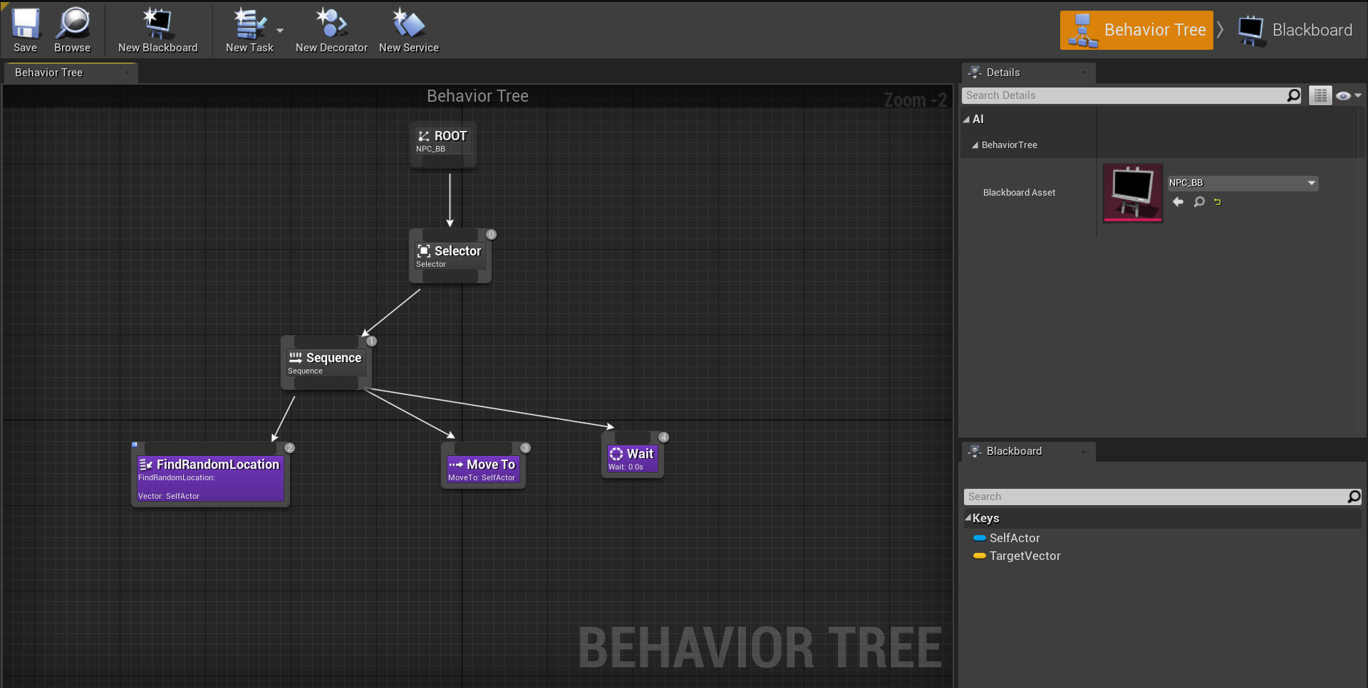
Coding for AI

Slide 23
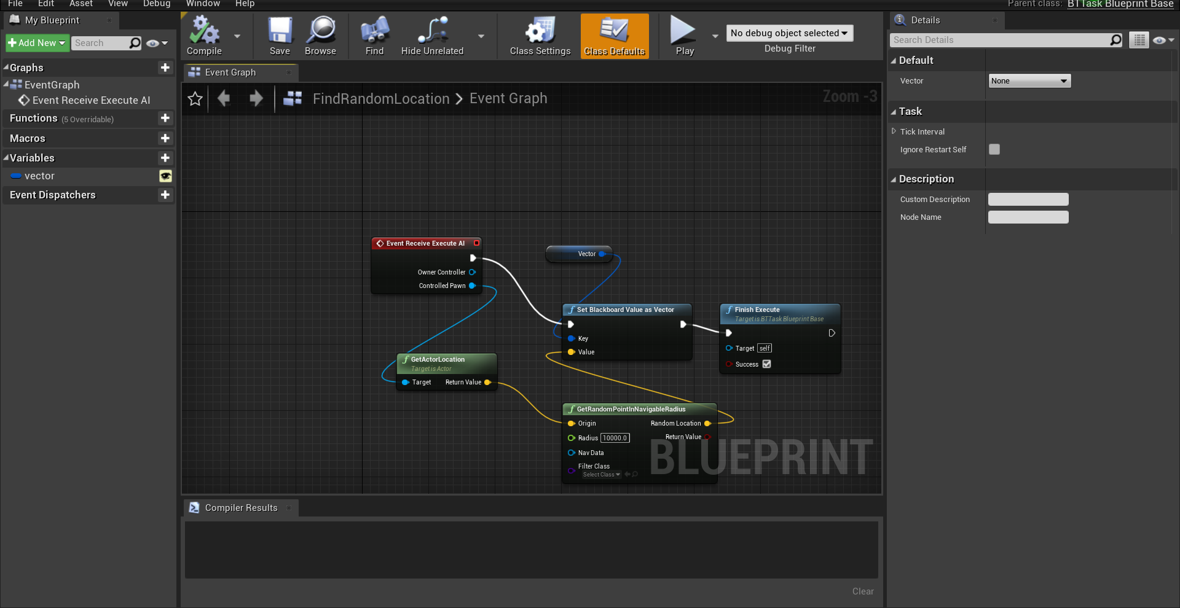

Slide 24
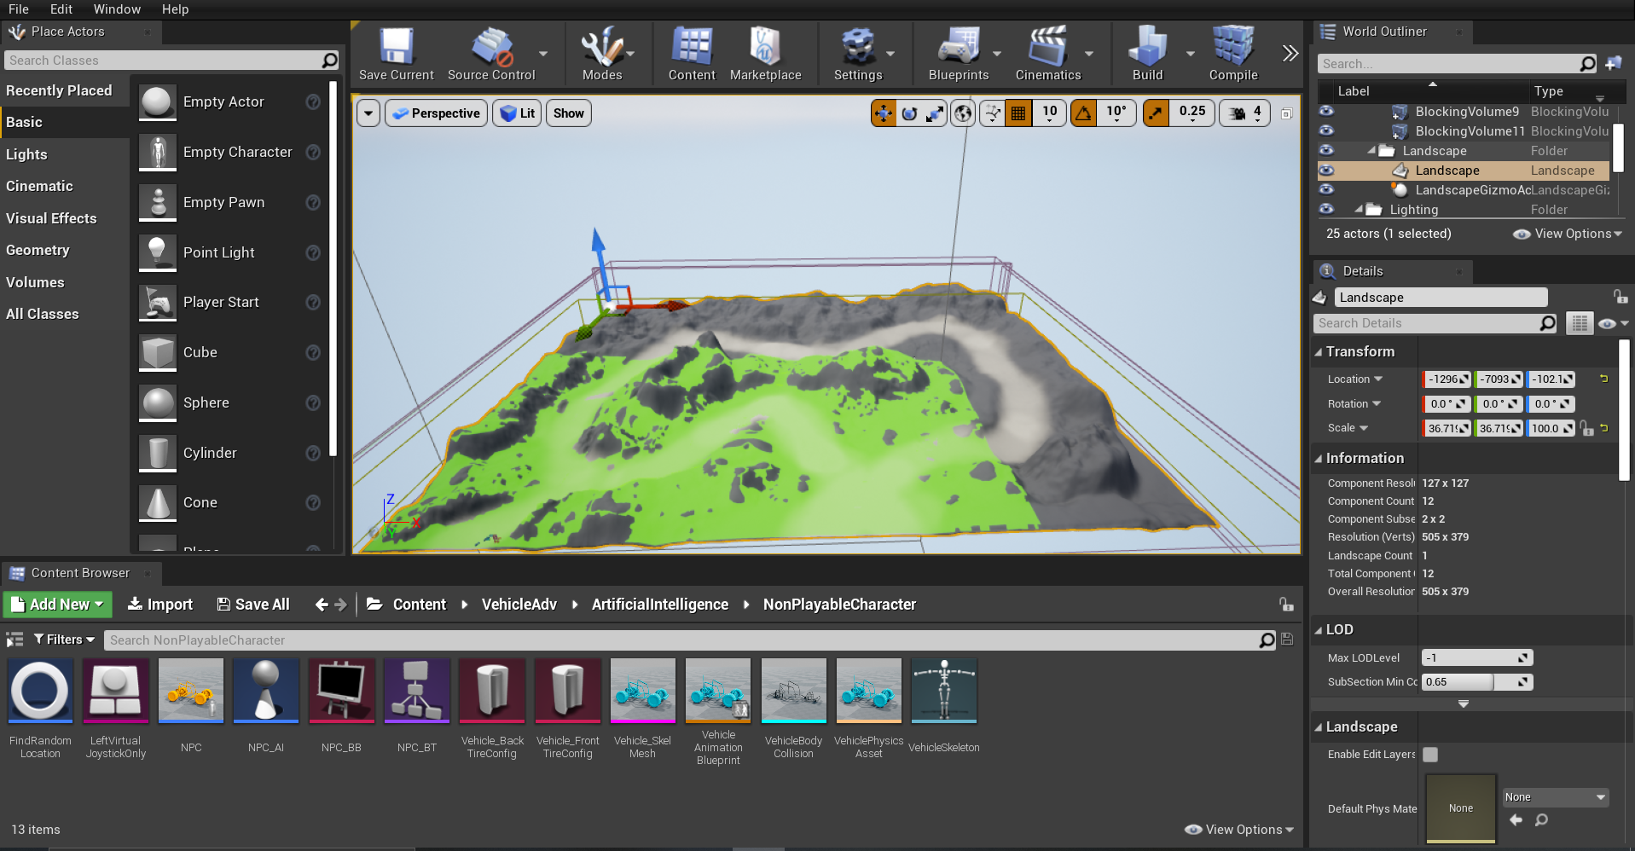

Slide 25
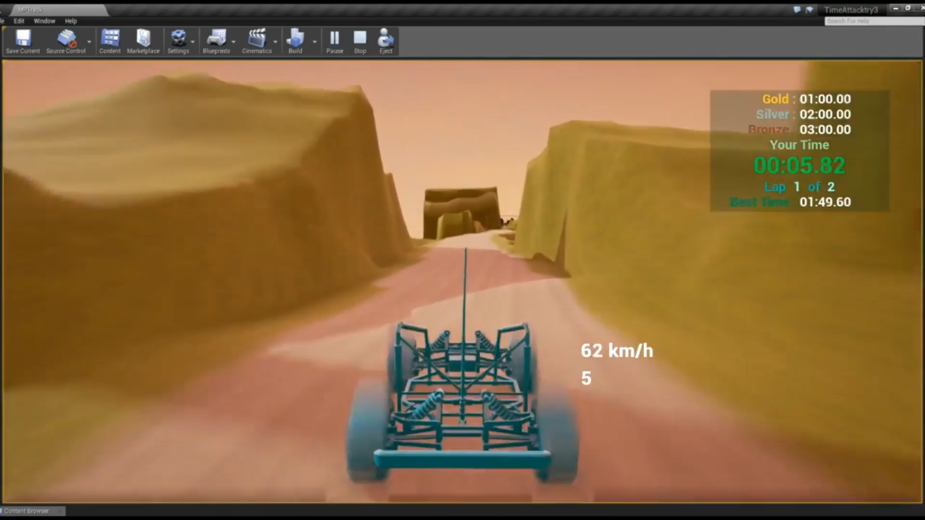

Slide 26
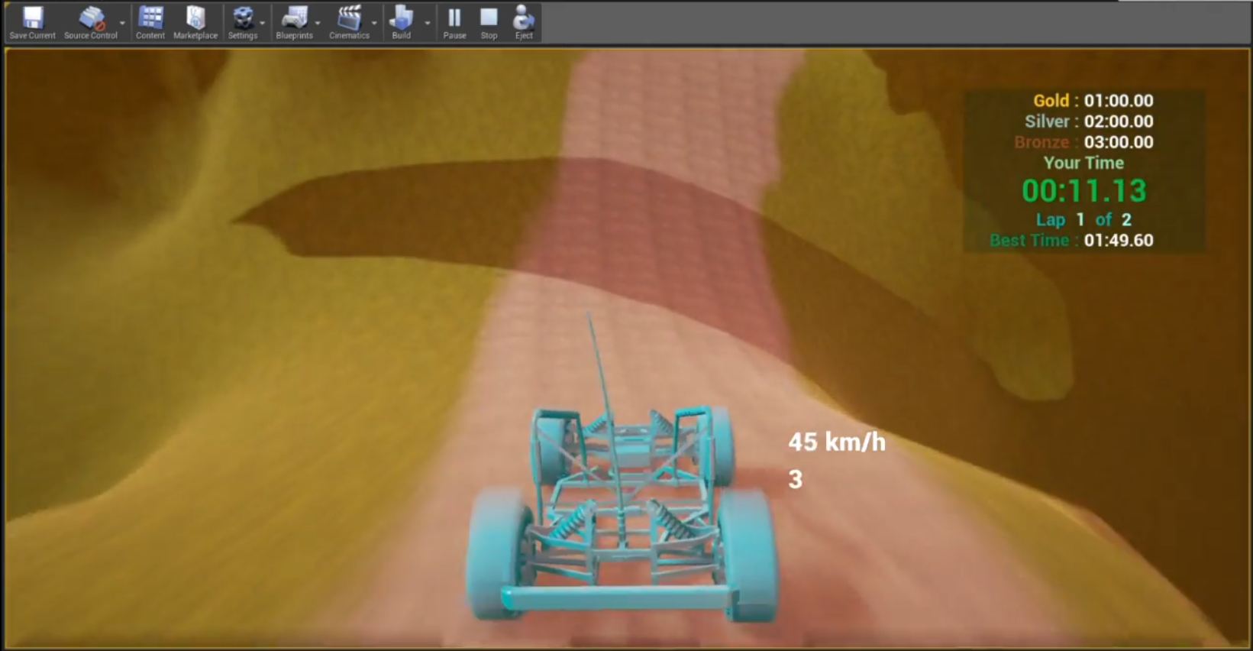

Slide 27
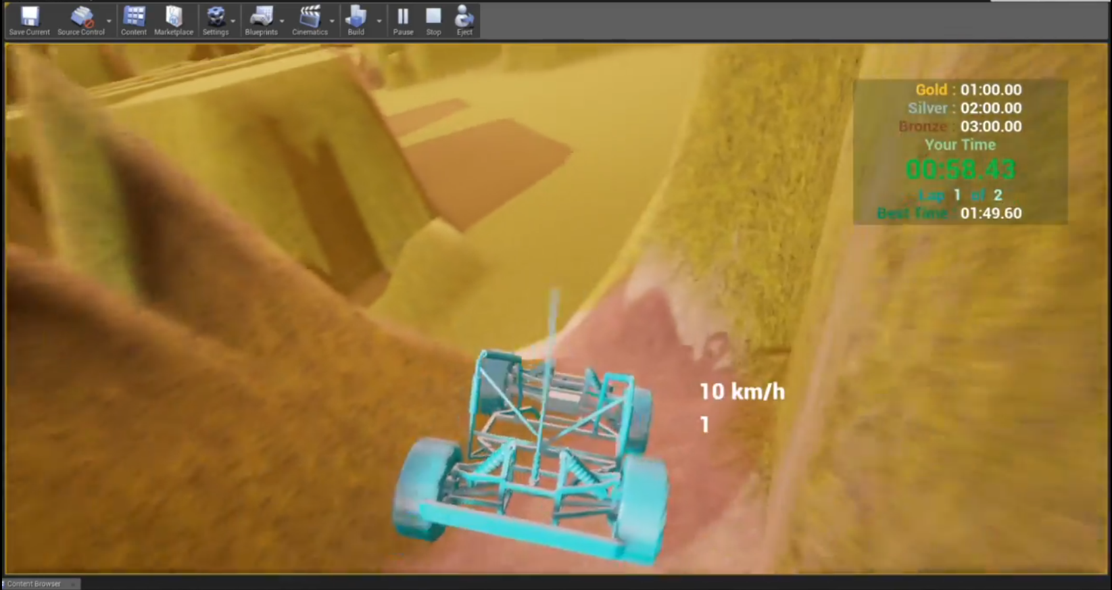

Slide 28
Testing
The primary objective of testing is discovery and documentation of bugs.
It is done by the following methods
Functionality Testing: This literally means the method to identify bugs or errors in a game that may affect the user-experience.
Compatibility Testing: This is used to find whether a game is functioning properly or not with respect to the hardware, graphics and software configuration that the device is built with.
Regression Testing: It is done to make sure that new changes didn’t break the working components of the software.
Ad Hoc testing: In this method the testers try to do unplanned moves in order to intentionally break the software.

Slide 29
Result and Discussion
The tests mentioned above gave the following results:
The physics implementation of the game is working as expected the friction, rate of acceleration, the suspension system of the car all are working fine.
The game is fully compatible with windows 10 systems with hardware requirements similar if not better.
Errors
When the car collides and turn upside down the has to restart in order for player to continue.
The graphics fail to load sometimes but this error is easily rectifiable by restarting the game.
The AI implementation in the game is faulty, sometimes the NPC fails to spawn and even when car spawns the AI fails to move the car.

Slide 30
Conclusion
The car, physics, graphics all are working fine except for the artificial intelligence which fails to initialize properly, if at all.

